Slide 1

Course: ARM Processor & Applications (15EECC207)
Faculty In Charge: Supriya Katwe
Preeti Pillai
Bhagyashree K

Slide 2
Course: ARM Processor & Applications
Course Outcomes (COs):
At the end of the course the student should be able to:
Discuss advanced microprocessor architecture and pipeline structure.
Write assembly language programs with a tradeoff between size and complexity and test it using development tools.
Develop an assembly level program for the given application using ARM or THUMB or both instruction set.
Discuss the concept of interrupt and their application.
Develop a C code for interfacing different ON/OFF board peripheral devices to LPC 2148 controller.

Slide 3
Unit-III Introduction to LPC2148 & GPIO Programming
Lesson Schedule
Sl No. | Topic
1 | Introduction to lpc2148
2 | Features
3 | GPIO Register Configuration
4 | LPC2148 Board
5 | Algorithm
6 | Program
7 | Simulation

Slide 4
Introduction
The NXP (founded by Philips) LPC2148 is an ARM7TDMI-S based high-performance 32-bit RISC Microcontroller.
LPC is Linear Programming Control. in LPC2148 and 2148 is the version of LPC controllers.

Slide 5
LPC2148 Features
It has an on-chip static RAM of 32kB and an on-chip flash memory of 512kB.
45 GPIO lines
9 external interrupt pins
2 10-bit ADCs (ADC0 and ADC1).
2 32-bit timers/external event.
CPU clock up to 60 MHz, On-chip crystal oscillator and On-chip PLL.
Low power real-time clock(RTC)

Slide 6
LPC2148 Features Contd..
Multiple serial interfaces
2 UARTs (16C550),
2 Fast I2C-bus
2 SPI
Vectored interrupt controller with configurable priorities and vector addresses.
A 10-bit DAC

Slide 7
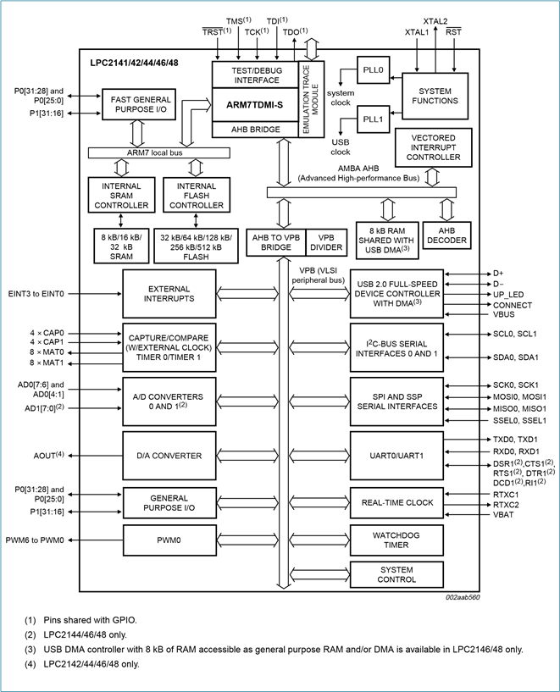

Slide 8
Applications
Industrial Control
Medical Systems
Communication Gateway
Access Control
Embedded Soft Modem
General Purpose Applications

Slide 9
GPIO
LPC2148 has two 32-bit General Purpose I/O ports.
1. PORT0
2. PORT1
PORT PINS | TYPE | DESCRIPTION
P0.0-P0.31 P1.16-P1.31 | Input/output | General purpose input/output. The number of GPIOs actually available depends on the use of alternate functions.

Slide 10
PORT0 is a 32-bit port
Out of these 32 pins, 28 pins can be configured as either general purpose input or output.
1 of these 32 pins (P0.31) can be configured as general-purpose output only.
3 of these 32 pins (P0.24, P0.26 and P0.27) are reserved. Hence, they are not available for use. Also, these pins are not mentioned in pin diagram.

Slide 11
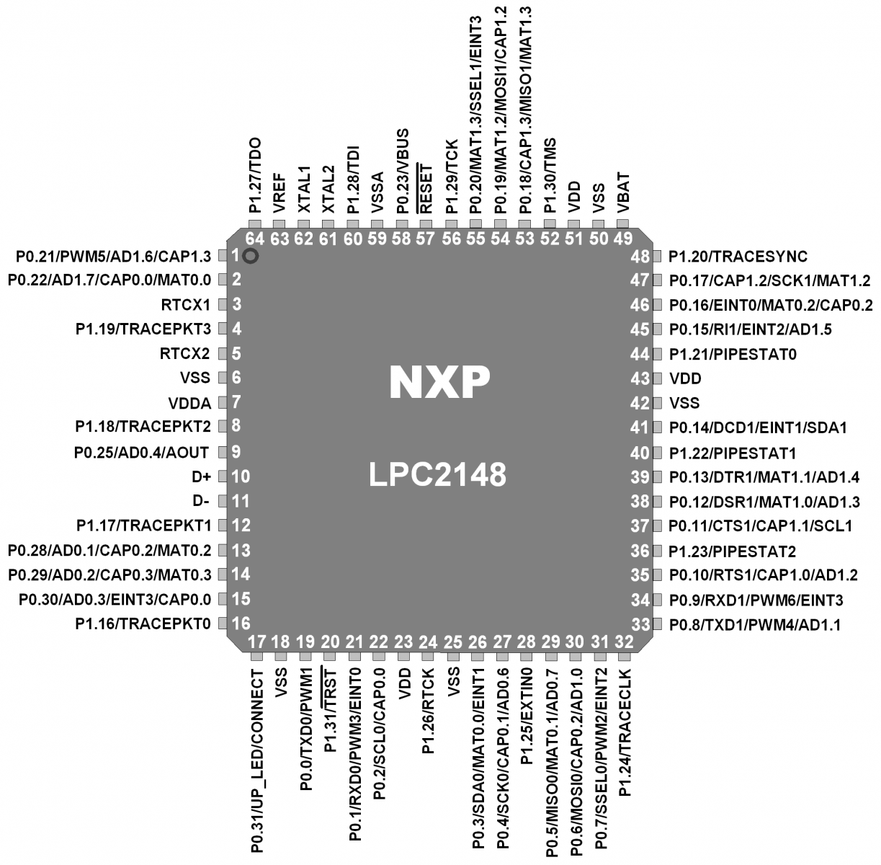
LPC2148 Pin Diagram

Slide 12
Register Configuration
PINSEL
IODIR
IOSET
IOCLR
IOPIN

Slide 13
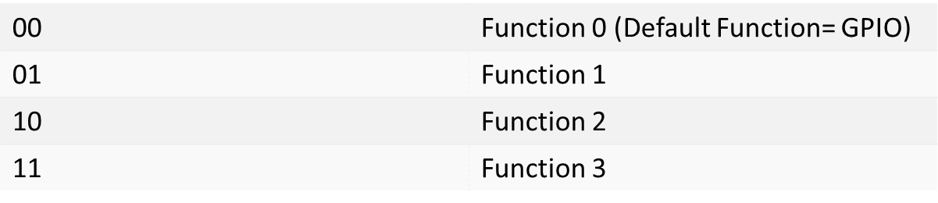

PINSEL: GPIO Pins Select Register
Pin Function Select Registers are 32-bit registers. These registers are used to select or configure specific pin functionality.
For Example PINSEL0 In LPC2148 for BIT P0.0

Slide 14
There are 3 Pin Function Select Registers in LPC2148:
PINSEL0 : - PINSEL0 is used to configure PORT0 pins P0.0 to P0.15.
2. PINSEL1 : - PINSEL1 is used to configure PORT0 pins P0.16 to P0.31.
3. PINSEL2 : - PINSEL2 is used to configure PORT1 pins P1.16 to P1.31.

Slide 15
IODIR
IODIR0/ IODIR1
GPIO Port Direction control register
Controls the direction of each Port Pin
IODIR0 is used to configure pins of Port 0-P0 as input or output pins.
1= Output Pin 0= Input Pin
Example: IODIR0=0x0000FFFF means pins (P0.16-P0.31) are configured as INPUT pins and pins (P0.0-P0.15) are configured as OUTPUT pins.

Slide 16
IOSET
IOSET0/ IOSET1
GPIO Port Output Set registers
This register controls the state of output pins
Writing ones produces highs at the corresponding port pins.
Writing zeroes has no effect.
It is used to set pins of PORT0/PORT1 to logic 1.
Example: IOSET0=0x0000FFFF will set pins P0.0 to P0.15 at logic 1. It will not affect other pins.

Slide 17
IOCLR
IOCLR0/ IOCLR1
GPIO Port Output Clear registers.
This register controls the state of output pins.
Writing ones produces lows at the corresponding port pins
Writing zeroes has no effect.
It is used to set pins of PORT0/PORT1 to logic 0.
Example: IOCLR0=0x0000FFFF will set pins P0.0 to P0.15 at logic 0. It will not affect other pins.

Slide 18
IOPIN
IOPIN0/ IOPIN1
GPIO Port Pin value register.
The Current State of the GPIO configured port pins can always be read from this register, regardless of pin direction.
Example:
Int x;
x=IOPIN0;

Slide 19
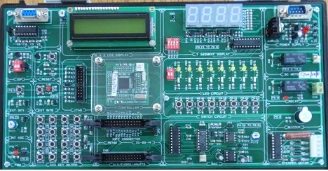
LPC2148 Development Board

Slide 20
Board Specifications
12MHz Crystal
On board voltage regulator
4 LEDS
Buzzer Interface
4 DIP switches
16x2 LCD Display
2 –digit multiplexed Seven Segment Display Interface
4x4 key Matrix

Slide 21
Board Specifications Contd..
Stepper Motor Interface
Dc Motor Interface
Relay Interface
8 –bit DAC Interface
Onchip ADC interface circuitry through pot
External interrupt 0 interfacing
External interrupt 1 interfacing

Slide 22
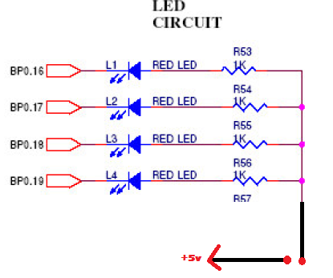
LED Circuit
4 LEDS connected in common anode fashion.
Logic 0 at port = LED ON
Logic 1 at port = LED OFF

Slide 23
Algorithm
Blink LEDs connected on pins P0.16-P0.19
Step-1: Select the GPIO PORT Pins using PINSEL0.
Step-2: Specify the direction of pins as output using IODIR0.
Step-3: Clear pins P0.16-P0.19 using IOCLR0 to turn ON LEDs
Step-4: Wait for sometime
Step5: Set pins P0.16-P0.19 using IOSET0 to turn OFF LEDs
Step-6: Go to step-2.

Slide 24
First Program
#include<lpc21xx.h>
void delay(unsigned int);
int main()
{
PINSEL0=0X00000000;
IODIR0=0X000F0000; // Configure P0.16-P0.19 as Output
while(1)
{
IOCLR0=0X000F0000; // CLEAR (0) P0.16-P0.19 to turn LEDs ON
delay(100000);
IOSET0=0X000F0000; // SET (1) P0.16-P0.19 to turn LEDs OFF
delay(100000);
}
}
void delay(unsigned int j)
{ unsigned int i;
for(i=0;i<j;i++);
}

Slide 25
Summary
Lpc2148 Features
Gpio Programming Registers
Board Specifications
LED Blink Simulation

Slide 26
Thank You

